Slide 1
CARING for the CREATION
What the Bible says

Slide 2
The Creation

Slide 3
Gen 1:1 In the beginning God created the heavens and the earth. (NIV)
Gen 1:11 ...'let the land produce vegetation: seed-bearing plants and trees on the land that bear fruit with seed in it ...'
Plants were created, with seeds to reproduce their own species.
Gen 1: 21 God created the great creatures of the sea ...and every winged bird (NIV)
Gen 1:22 And God blessed them, saying, Be fruitful, and multiply... (AV)
The animals were first to be given this blessing.
Gen 1:24 And God said, "Let the land produce ...livestock, creatures that move along the ground, and wild animals ..."
Gen 1:31 And God saw every thing that he had made, and, behold, it was very good. (AV)

Slide 4
Father, Son and Holy Spirit are linked at the Creation
Jn 1:3 Through him all things were made; without him nothing was made that has been made.
Heb 1:2 ...he has spoken to us by his Son ...through whom he made the universe.
Gen 1:1 ...and the spirit of God was hovering over the waters
All things were created by God; Father, Son and Holy Spirit; three persons in eternal fellowship.

Slide 5
Humans made in God’s image
Gen 1:26 Then God said, "Let us make man in our image ...and let them rule over the fish ...the birds ...the livestock ...all the earth and over all the creatures that move along the ground."
We are created in God's image; to have His holy, upright character, whether we be male or female.
The word to 'have dominion or rule over', according to Dr Matthew Sleeth in his book, 'Serve God, Save the Planet,' is derived from a Hebrew term RADA meaning 'a point higher up on the root of a plant.

Slide 6
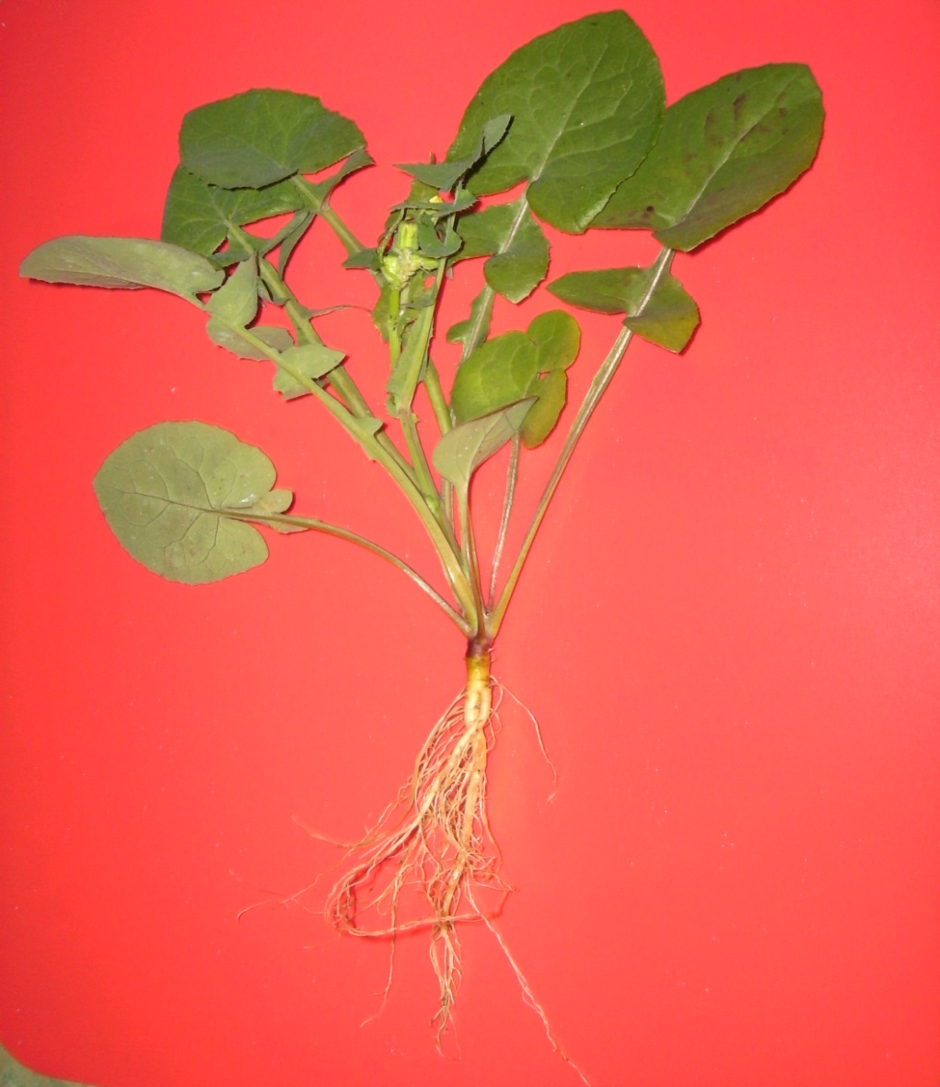
Can you identify ‘rada’ on this plant?

Slide 7
‘Rada’ is where the centre of strength of the plant is located; the point from which the roots radiate below ground and the shoots radiate above ground. Just as a good leader is to be the centre of strength for the group he rules, so also, humans are to be the centre of strength for all other living species, to rule with delegated authority from God for the good of the other species and accountable to God for their rule.
Jn 13: 5 After that, he ... began to wash his disciples' feet, drying them with the towel that was wrapped around him.
Jesus shows us what Christian leadership is all about; he is Lord, but he is a servant Lord. We have been set in charge of all living things for their good, to serve the Creation with humility.

Slide 8
Be fruitful and multiply
Gen 1:28 God blessed them and said... "Be fruitful and increase in number; fill the earth and subdue it. Rule over the fish ...birds ...every living creature..."
A blessing is a good wish for personal well-being and happiness. It is different from a command.
Gen 6:10 And of every living thing - two of every kind shalt thou bring into the Ark.
Gen 9:1 ...God blessed Noah and his sons saying... "Be fruitful and increase in number..."
Gen 1: 29, 30 "I give you every seed-bearing plant ...for food. And to all the beasts of the earth and all the birds of the air ...everything that has the breath of life ...I give every green plant for food."

Slide 9
tutle

Slide 10
What is the CONTEXT ? The context of ‘Go forth and multiply’ is one of NEAR ZERO POPULATIONS

Slide 11
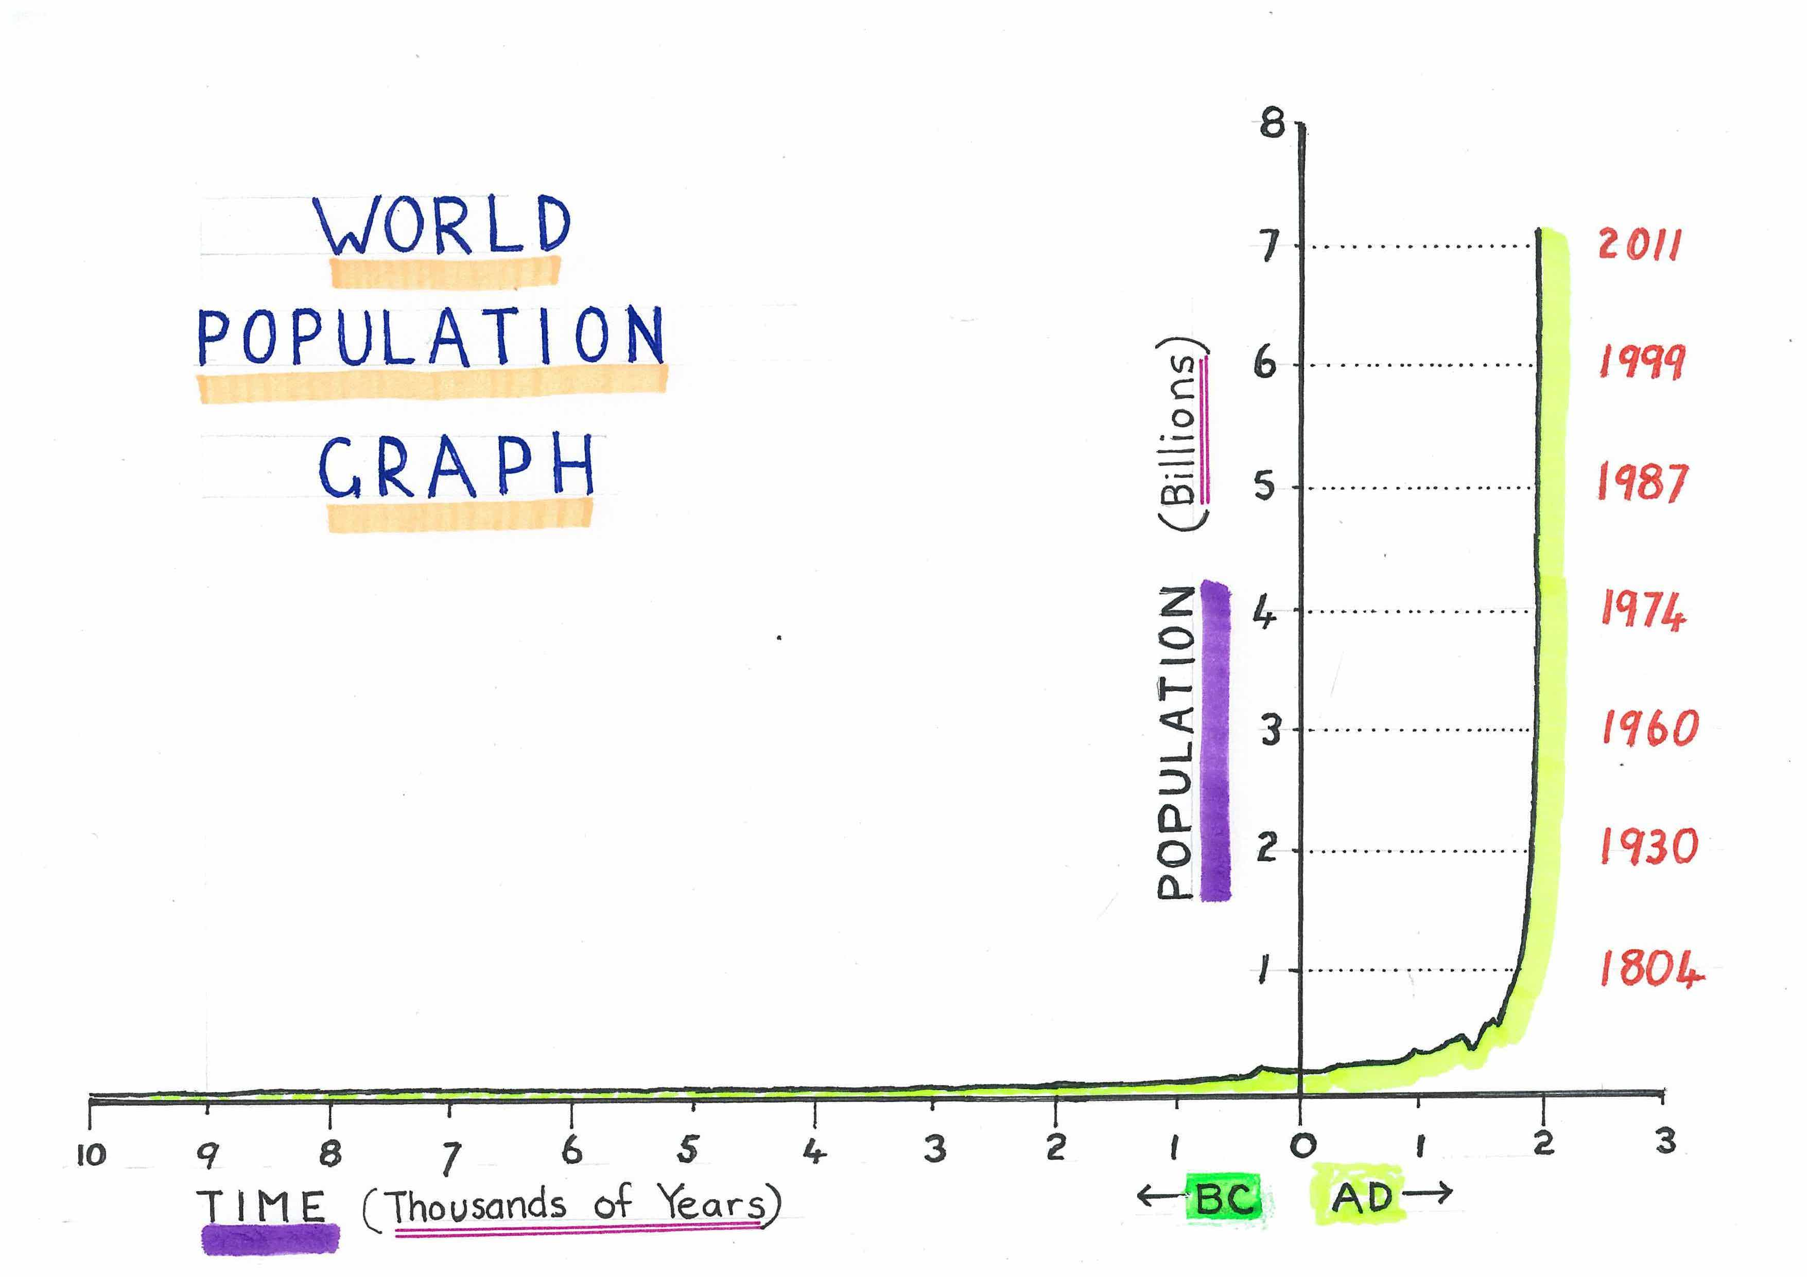

Slide 12
THE FALL – Broken relationships
God
Broken
Self
Broken
Broken
Others
Nature

Slide 13
Nature … Before and After the Fall
Gen 2:15 The Lord God took the man and put him in the garden of Eden to work it and take care of it.
The Hebrew used is 'abad', meaning 'to serve' and the idea of conservation, of use without destruction, is implied.
… following the Fall …
Gen 3:17 "Cursed is the ground because of you ...It will produce thorns and thistles..."
Gen 3:19 …dust thou art, and unto dust shalt thou return. (AV)
The name ‘Adam’ means ‘from the earth’

Slide 14
God’s love for the Earth He made …
Ps 24:1 The earth is the Lord's, and everything in it
Ps 50:10 Every animal of the forest is mine, and the cattle on a thousand hills, and the creatures of the field are mine
Ps 145:16 You open your hand and satisfy the desires of every living thing.
Gen 9:9 I now establish my covenant with you ... and with every living creature ...and all the wild animals ...every living creature on earth
Job 38:41 Who provides food for the raven when its young cry out to God?
Job 39:26 Does the hawk take flight by your wisdom?
Job 39:27 Does the eagle soar at your command and build its nest on high?

Slide 15
All Creation has its own intrinsic value, independent of people

Slide 16
Heb 4:13 No creature is hidden from God’s sight.

Slide 17
Covenant and Law
Gen 9:17 ...God said to Noah, "This is the sign of the covenant I have established between me and all life on Earth."
It was the rainbow, which appears in the sky after rain. Water gives life to humans and animals alike. The rainbow serves to remind us of God's provision for man and beast.
Ex 20:10 ...the seventh day is a Sabbath to the Lord your God. On it you shall not do any work, neither you, nor your son or daughter ...nor your animals...
Animals were to share in the seventh day of rest.
Lev 25: 2, 4, 5 When you enter the land ...the land itself must observe a Sabbath ...the land is to have a year of rest
Ex 23:10 - 12 For six years you shall sow your land and gather ... but the seventh year you shall let it rest and lie fallow, that the poor ... may eat; and what they leave, the wild beasts may eat.

Slide 18
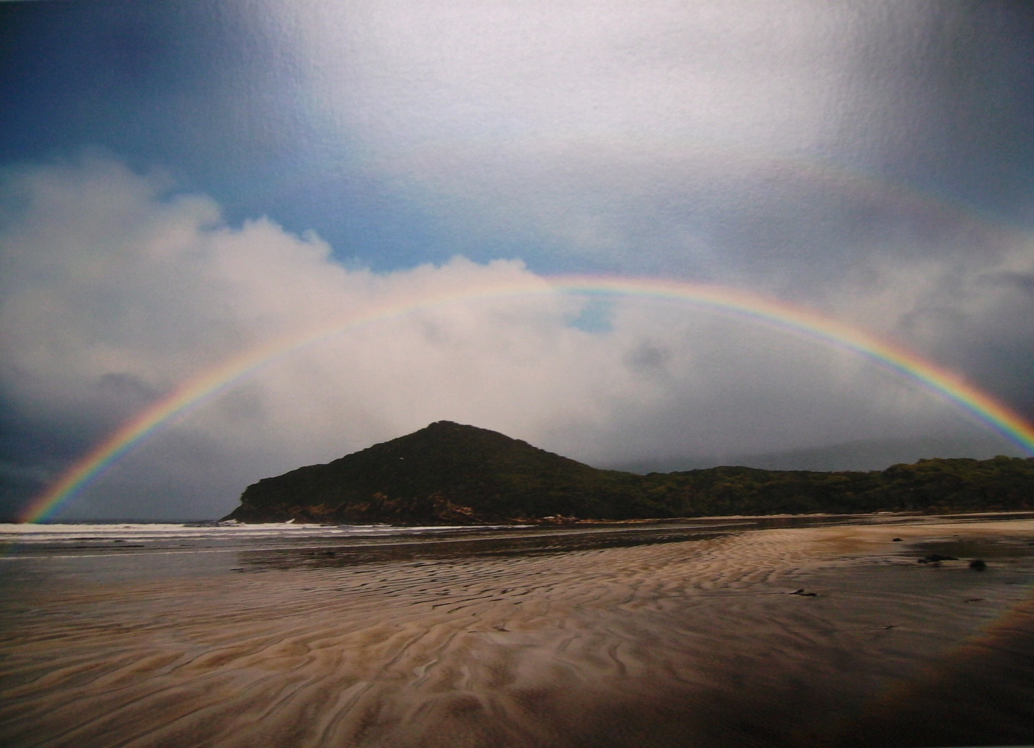
WILD TASMANIA - Rob Blakers

Slide 19
Care for nature by God and humans
Lev 25:6, 7 Whatever the land yields during the sabbath year will be food for you ... as well as for your livestock and the wild animals in your land.
Ps 36:6 You are concerned for both men and animals alike (Living Bible)
Ex 23:5 If you see the donkey of someone who hates you fallen down under its load, do not leave it there, be sure you help him with it.
Deut 25:4 Thou shalt not muzzle the ox when he treadeth out the corn (AV)
(That is, don't prevent the animal from eating a little corn when his work is preparing your own food.)
Prov 12:10 A righteous man cares for the needs of his animal.

Slide 20
When God’s laws are broken …
Is 5:8 - 10 Woe to you who add house to house and join field to field till no space is left and you live alone in the land. ...A ten-acre vineyard will produce only a bath of wine (22L)
Jer 23:15 I will make them eat bitter food and drink poisoned water because ...ungodliness has spread throughout the land.
Hosea 4:3 That is why your land is not producing ...and all living things grow sick and die; … and even the fish begin to disappear
Joel 1:18 - 20 Even the wild animals cry to you because the water courses are dried up, and fire has devoured the pastures of the wilderness
Lev 26:33 - 35 "I will scatter you ... Then at last the land will enjoy its sabbath years all the time that it lies desolate and you are in the country of your enemies ...the land will have the rest it did not have during the sabbaths you lived in it."

Slide 21
… there are consequences
2 Chron 36:21 Thus the word of the Lord spoken through Jeremiah came true, that the land must rest for seventy years to make up for the years when the people refused to observe the Sabbath. (Living Bible)
Is 14:7, 8 The whole world has rest and is at peace; it breaks into cries of joy. The pines themselves and the cedars of Lebanon exult over you: 'Since you have been laid low, ' they say, 'No man comes up to fell us.'
When humans failed in their duty of care towards the land, their resulting misfortunes gave the land a break.
Deut 29: 19, 23 Let no one blithely think, when he hears the warnings of this curse, "I shall prosper, even though I walk in my own stubborn way!" ...They will see that the whole land is alkali and salt, a burned over wasteland, unsown, without crops ...”
Deut 32:47 These laws are not mere words ...they are your life!

Slide 22
God’s plan to change hearts
Deut 5: 29 Oh that they would have a heart for me … then all would go well with them in the future.
2 Chron 7:14 If my people …will humble themselves …and turn from their wicked ways …then I will hear from heaven and forgive their sins and heal their land.
Jer 31:33 I will put my law in their inward parts, and write it in their hearts.
The prophet Jeremiah tells of a wonderful plan God has to set things right. This plan is implemented in the New Testament.
Jn 3:16 God so loved the world that he gave his only begotten Son (AV)

Slide 23
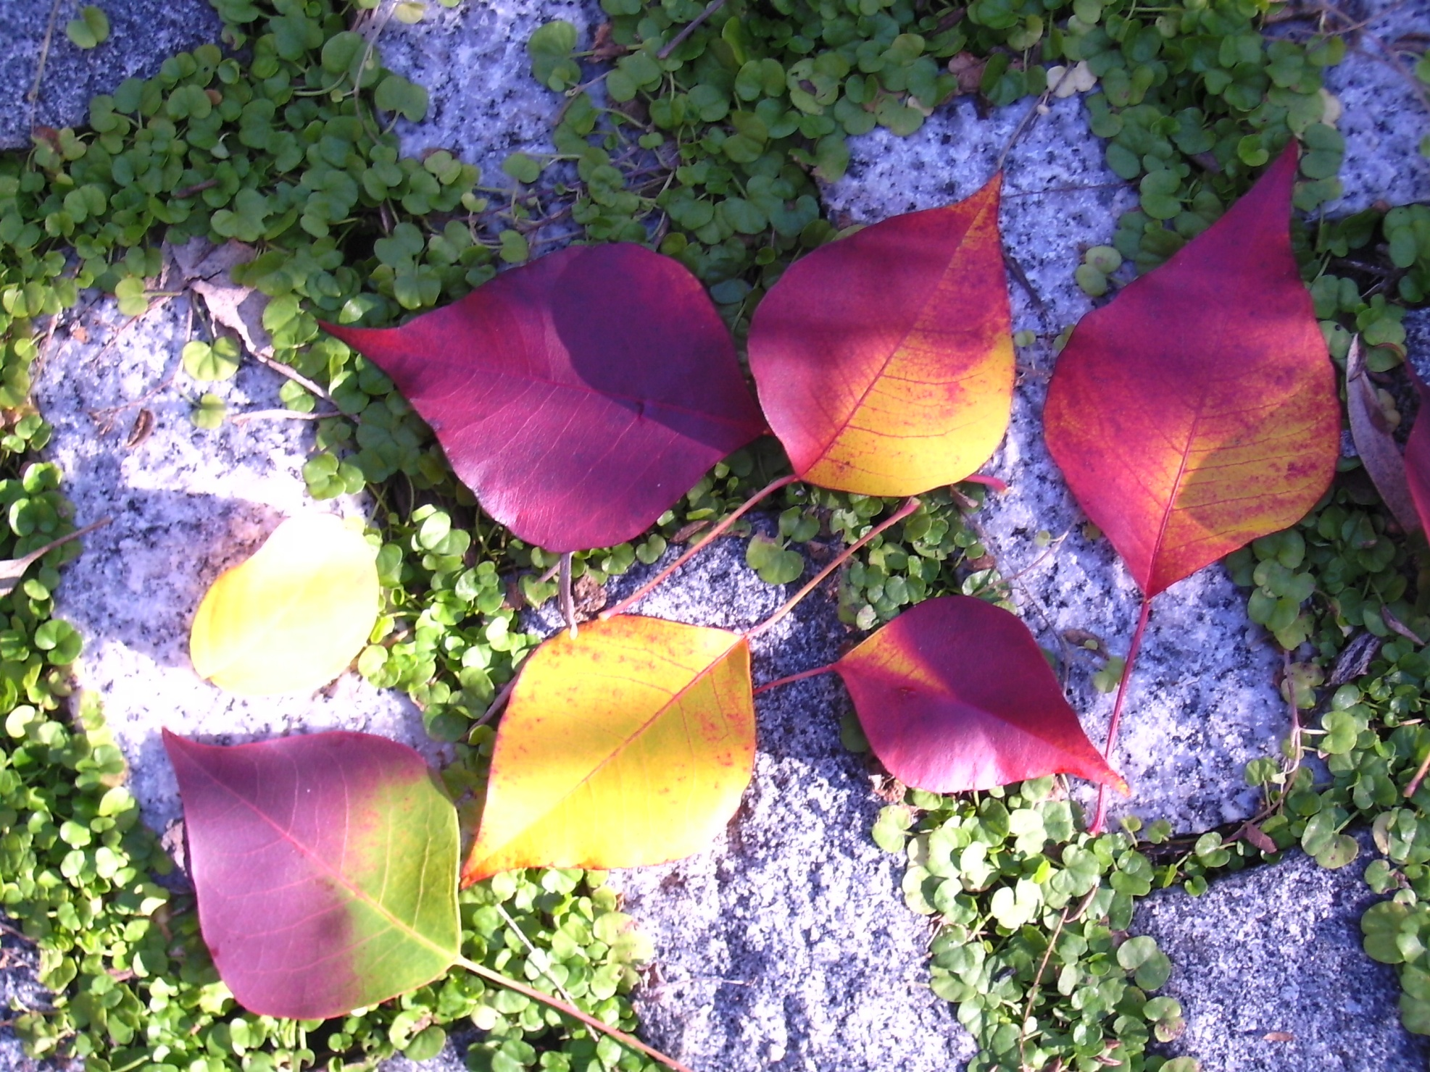
If the whole Creation suffered in the Fall, may we expect to find other species caught up in God’s plan of salvation? Yes, because the ‘world’ includes the plants and animals.

Slide 24
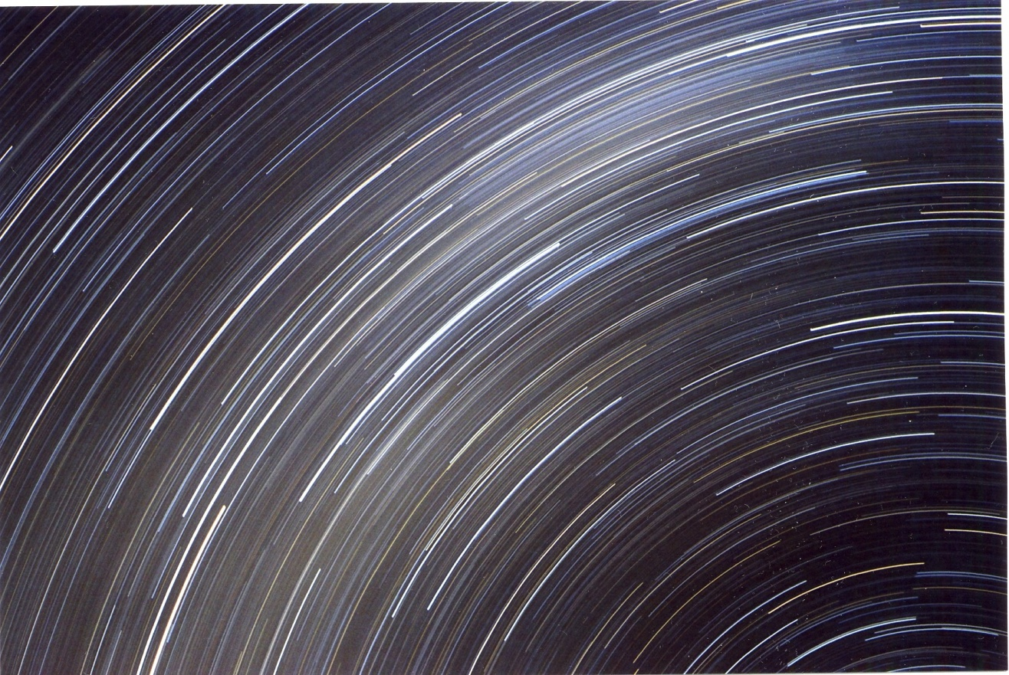
Col 1:19, 20 For God was pleased to have all his fullness dwell in him and through him to reconcile to himself all things … by making peace through his blood, shed on the cross.

Slide 25
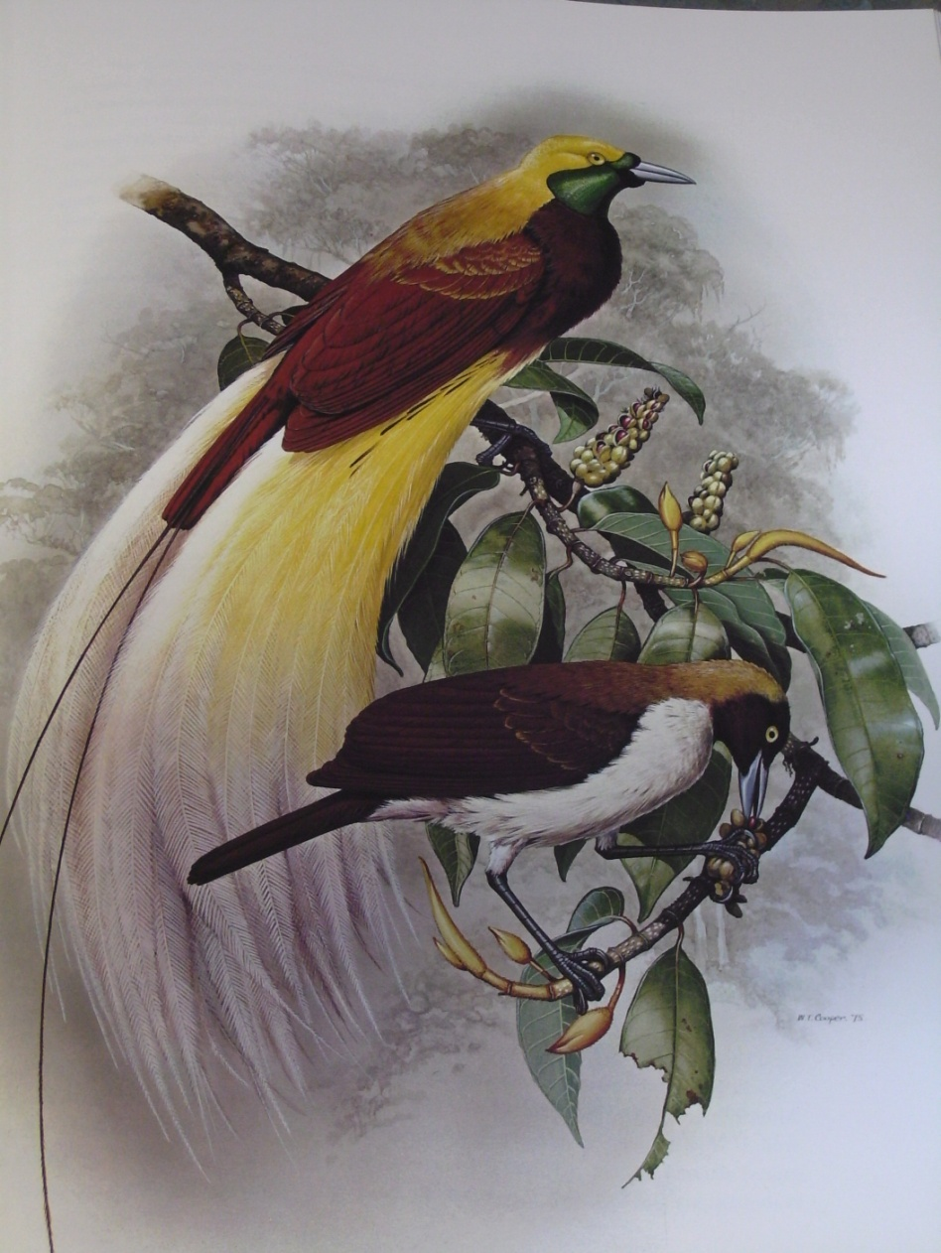
What did Jesus say concerning animals?
Lk 12:6 Are not five sparrows sold for two pennies? Yet not one of them is forgotten by God.
Jn 10:11 I am the good shepherd. The good shepherd lays down his life for the sheep.
The value of the sheep to God underpins the validity of this text as do other loving images of sheep and shepherd in the Bible.
Mt 23:37 …how often I have longed to gather your children together, as a hen gathers her chicks under her wings, but you were not willing.

Slide 26
Does God want us to care about plants and animals?
Ro 8:23 We know that the whole creation has been groaning as in the pains of childbirth right up to the present time.
Ro 8:19 – 22 The creation waits in eager expectation for the sons of God to be revealed …in the hope that the creation itself will be liberated … and brought into the glorious freedom of the children of God.

Slide 27
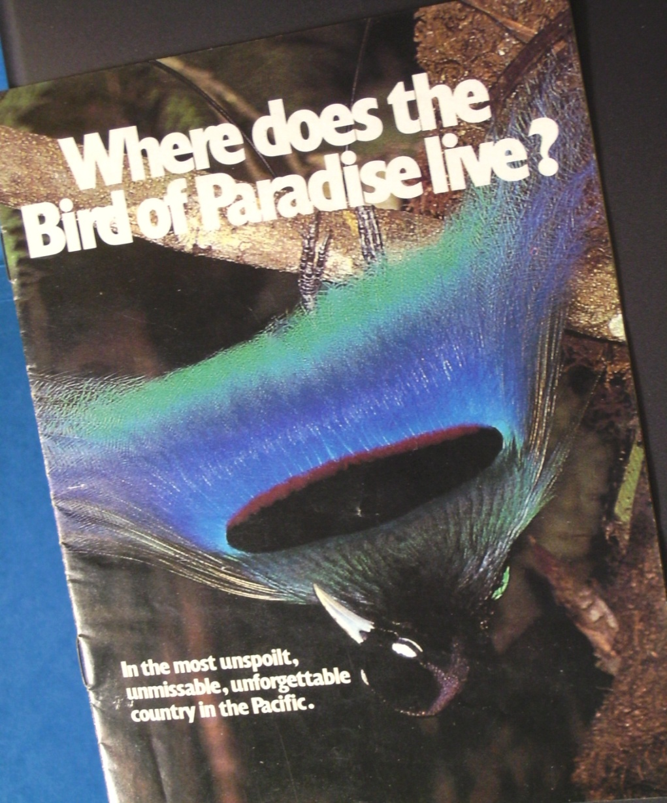
How are we enabled to do God’s work in the world?
Blue Bird of Paradise, Papua New Guinea
When our hearts are changed through the Cross.

Slide 28
THE CROSS - Healed relationships
God
Restored
Self
Restored
Restored
Others
Nature

Slide 29
Mk 16:15 … preach the good news to all creation

Slide 30
What about the ‘End Times’?
(eschatology)
Is 11:6,7,9 The wolf will live with the lamb; the leopard will lie down with the goat …and a little child will lead them. The cow will feed with the bear and the lion will eat straw like the ox …they will neither harm nor destroy on all my holy mountain.
Is 43:20 The wild animals honour me
Hos 2:18 At that time I will make a treaty between you and all the wild animals, birds and snakes, not to fear each other any more.
A time of peace and reconciliation is described.
Rev 5:13 Then I heard every creature in heaven and on earth and under the earth and on the sea, and all that is in them singing …

Slide 31
Yes, every creature
… praising God
and singing!

